Slide 1
Mortgage Loans Analytics
Loan Type: to indicate the loan if fixed rate, or balloon loan , or ARM, Loan program type: to indicate conforming loan, FHA/VA loan, Jumbo loan or sub-prime loan
Current Interest rate:
FICO Score: the updated fico score
LTV: the current loan to value ratio
Loan Size: the loan amount of the loan
Loan origination location (City & Zip)
Unit Types (Types of property)

Slide 2
Predicting mortgage demand using machine learning techniques
Linear Regression,
Logistic Regression
Random Forests (RF)
Support Vector Regression (SVR)
Support Vector Machine (SVM)
k-Nearest Neighbors
Decision Tree Classifier

Slide 3
Data Preparation
The goal of the Data Preparation stage is to transform and enrich the dataset so that it can be fed into the models. After the data is collected and explored, it can be pre-processed so that it can be used
directly in our predictive model. With the pre-processed data one can perform feature engineering

Slide 4
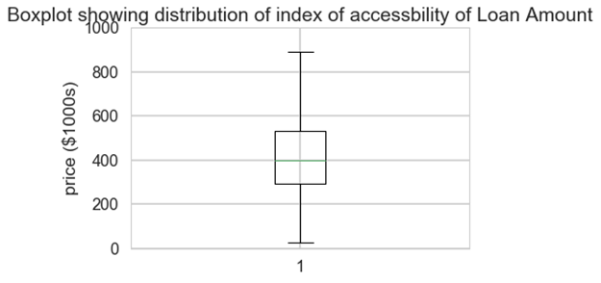
Distribution of Loan Amount

Slide 5
Mortgage interest rates
Mortgage interest rates have a significant impact on the amount of mortgage applications. If the interest rates are low, the mortgages are relatively cheaper for the borrower as they have to pay less interest, which leads to an increased amount of mortgage applications.
A high mortgage interest rate means the mortgage borrower pays a high amount of interest to the lender, which makes the mortgage less attractive for the borrower.

Slide 6
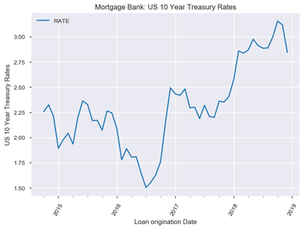
Interest Rate : In the short run rate may go ups and down but in the long run rate will go up. As housing price goes up, interest rate will go up to control the housing price.

Slide 7
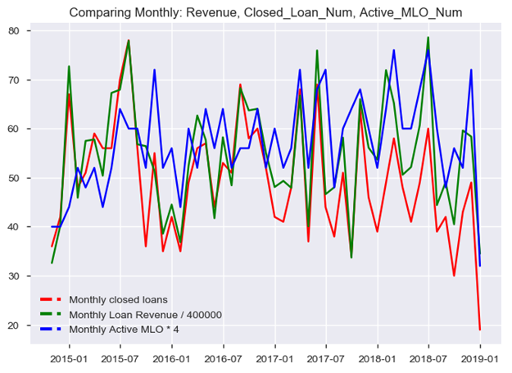
Monthly data of closed loan numbers , monthly revenue and active MLO numbers per months, all moving at the same direction.

Slide 8
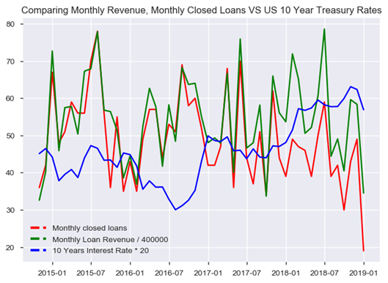
Correlation coefficient between Closed Loans & loan Rev: .83 Correlation coefficient between Interest & loans Closed Data: -.33

Slide 9
Random Walk Are Interest Rates or Monthly Loan Returns Prices a Random Walk?
Most returns prices follow a random walk (perhaps with a drift). We will look at a time series of Monthly Sales Revenue, and run the 'Augmented Dickey-Fuller Test' from the statsmodels library to show that it does indeed follow a random walk.
The p-value of the test on Loan Revenue is: 0.00019690419763896495
According to this test, p-value is very low (lower than 0.05). We reject the hypothesis that monthly_loan_rev_data follow a random walk. ''‘
The p-value of the test on Monthly Interest Rate is: 0.5839314748568241
According to this test, p-value is very is higher than 0.05. We cannot reject the hypothesis that Monthly Interest Rate prices follow a random walk.

Slide 10
Are Interest Rates Auto correlated? When we look at daily changes in interest rates, the autocorrelation is close to zero. However, if we resample the data and look at annual changes, the autocorrelation is negative.
The autocorrelation of annual interest rate changes is -0.97
We have notice how the daily autocorrelation is small but the annual autocorrelation is large and negative.

Slide 11
DATA COLLECTION
Besides Mortgage Application DataSet, we have joined two separate (10 Years US Treasury Rate, Home Supply Index) with our existing Mortgage Application DataSet to enhance predictive power of our model.
Join two DataFrames model_data1 & US10Y save the results in model_data
Integrated Monthly housing supply index data and merging with current dataset

Slide 12
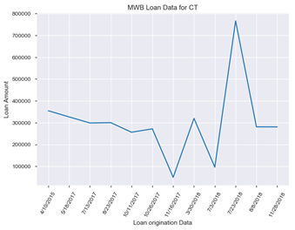
DATA EXPLORATION Since our dataset can be grouped per day to create meaningful visualizations. The dataset contains data from October 2014 until December 2018.

Slide 13
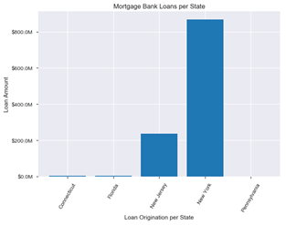
We can see that New York and New Jersey is the major Loan Origination market for the Bank.

Slide 14
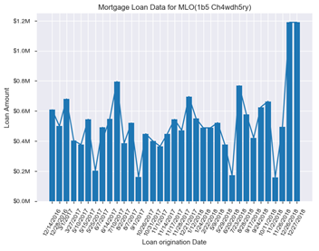
We can easily explore the Loan Origination history for particular MLO

Slide 15
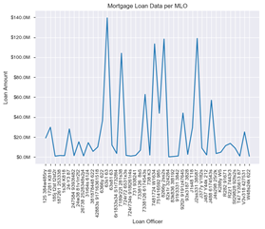
MLO Performance: Few MLO generates major portions of the sales revenue for the Bank, and many of the MLO is performing way below company standards.

Slide 16
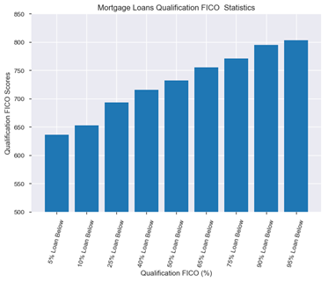
1. 90% of the FICO score is over 650. FHA Loan type could be only option with LOW FICO score; 2. Many bank uses cut-off points for FICO Score (640-680) for conventional mortgages. 3. FHA accepts FICO score below 600.

Slide 17
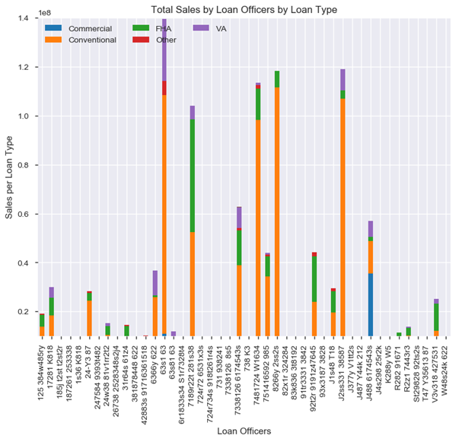
Let’s Analyze Mortgage Loan Officer’s Sales Volume per Loan Type. Processing different loan types need different expertise.

Slide 18
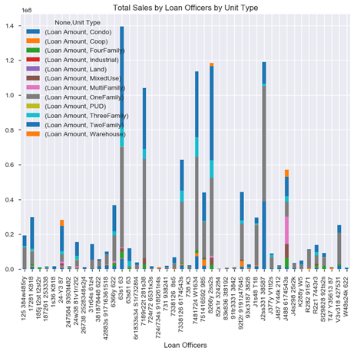
Similarly, we can explore MLO’s Sales Volume per Unit Type.

Slide 19
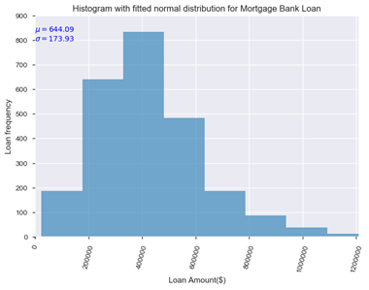
A histogram allows us to group purchases together so we can see how big the customer transactions are.
mean : 644.087
var : 30252.443
skew : 1.6231
kurt : 10.20

Slide 20
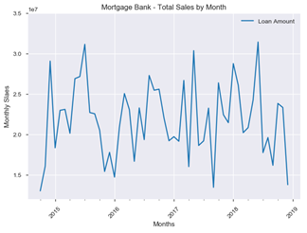
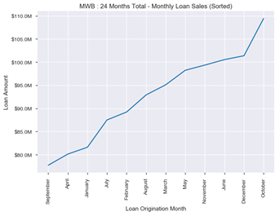
We can see that monthly mortgage loan sales volume varies between $15M and $32M. Another interesting find is Loan sales are at the peak during summer seasons.

Slide 21
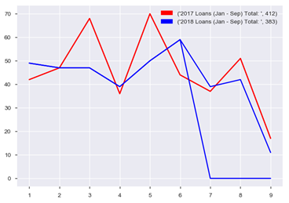
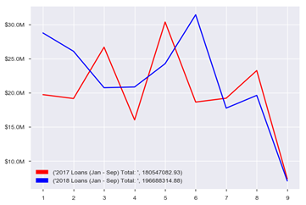
Comparing year-over-year Mortgage Bank Loan performance (Loan Application & Revenue) :

Slide 22
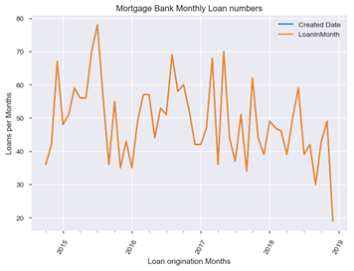
Monthly Loan numbers and Monthly Sales volumes are strongly positively correlated.
Pearson correlation coefficient between
Monthly Closed Loans
and
Monthly loan evenue is:
0.83

Slide 23
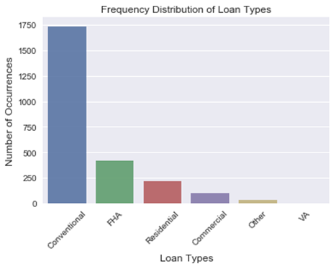
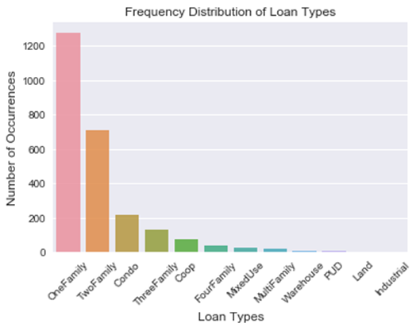
Visual exploration is the most effective way to extract information between variables

Slide 24
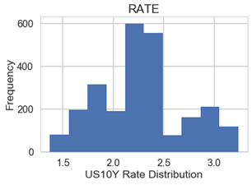
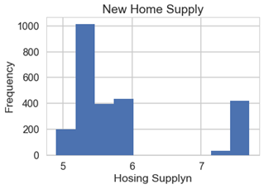
The distribution plot comparing US 10 Years Treasury Rate & New Home Supply shows that US 10Y RATE is normally distributed

Slide 25
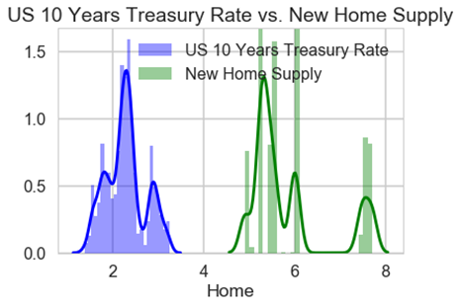
Home Supply goes up, Interest Rate goes up New Home Supply is skewed to the right.

Slide 26
DATA PREPARATION The Data Preparation stage contains three elements: data pre-processing, feature engineering and feature selection.
Encoding Categorical Data
There are different techniques to encode the categorical features to numeric quantities.
The techniques are as following:
Replacing values
Encoding labels
One-Hot encoding

Slide 27
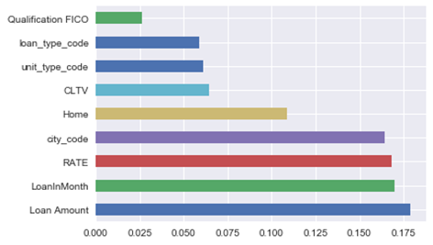
DATA PRE-PROCESSING In the data pre-processing phase we pre-process our data to a suitable format for our predictive model.
This phase consists out of the following steps:
Handling Categorical Data
Preprocessing: scaling
FEATURE ENGINEERING
FEATURE SELECTION
Univariate Selection
Feature Importance
Correlation Matrix with Heatmap

Slide 28
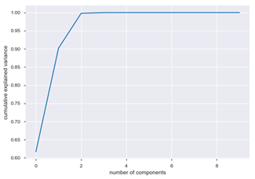
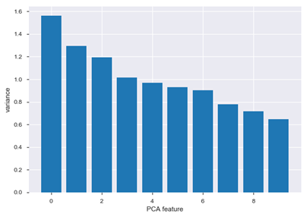
Using PCA for dimensionality reduction involves zeroing out one or more of the smallest principal components, resulting in a lower-dimensional projection of the data that preserves the maximal data variance.

Slide 29
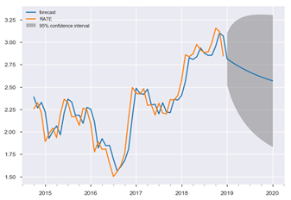
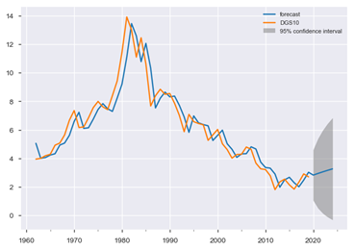
There is some mean reversion in interest rates over long horizons. When interest rates are high, they tend to drop and when they are low, they tend to rise over time. Currently they are below long-term rates, so they are expected to rise, but an AR model attempts to quantify how much they are expected to rise.

Slide 30
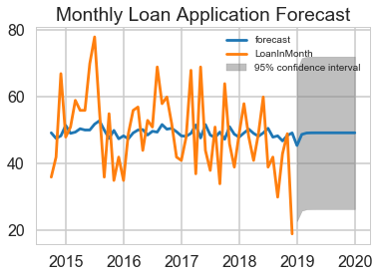
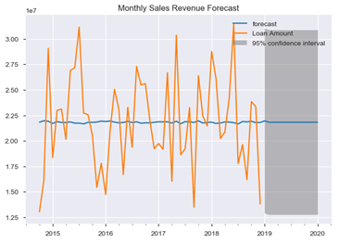
Forecast Using ARIMA Model: Monthly Loan Application vs. Loan Revenue

Slide 31
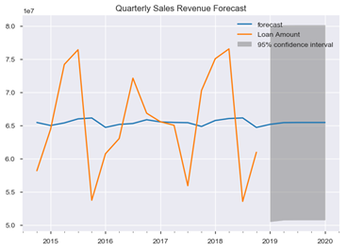
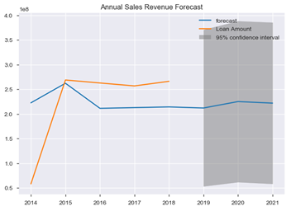
By end of 2021, with 95% confidence interval, Expected Revenue per Years will be around 220M. Low end is 70M & High End is 360M. With more annual data, we can do better annual revenue prediction.

Slide 32
Linear regression
Linear Regression - Root Mean Square Error : 0.298
Lasso model - Root Mean Square Error : 0.308
Ridge Regression - Root Mean Square Error : 0.298
Elastic Net - Root Mean Square Error : 0.308
Stochastic Gradient Descent - Root Mean Square Error : 0.298
Fitting Linear Regression using statsmodels
Fitting Linear Regression using sklearn

Slide 33
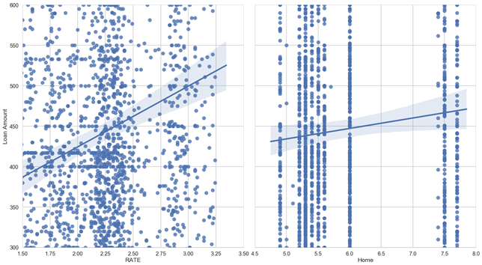

sns.pairplot(model_data, x_vars=['RATE', 'Home'], y_vars='Loan Amount', size=11, aspect=0.9, kind='reg')

Slide 34
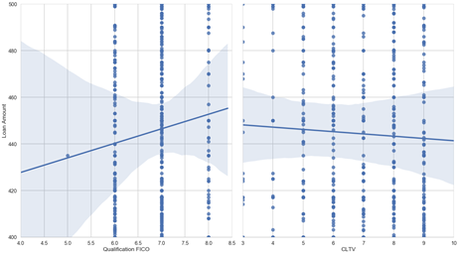
sns.pairplot(model_data, x_vars=['Qualification FICO', 'CLTV'], y_vars='Loan Amount‘]
Majority of the FICO scores between 600 and 820 (Loan Amounts in 1000s)
Majority of the CLTV scores between 30 and 100 (Loan Amounts in 1000s)
FICO goes up, Loan Amount goes up
CLTV goes up, Loan Amount Goes down

Slide 35
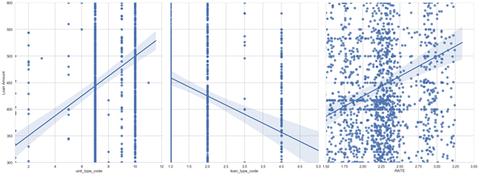
sns.pairplot(model_data, x_vars=['unit_type_code', 'loan_type_code', 'RATE'], y_vars='Loan Amount', size=11, aspect=0.9, kind='reg')
As num of unit decreases ave Loan Amount also decreases
loan_type_code: Conventional is high volume but Slightly low average loan amount
Two Family (Code = 10) has higher Loan Amount that three Family (Code = 9)
Conventional Mortgage has Higher Loan Amount FHA
Loan Amount increases with 10 Years Treasury Rate.

Slide 36
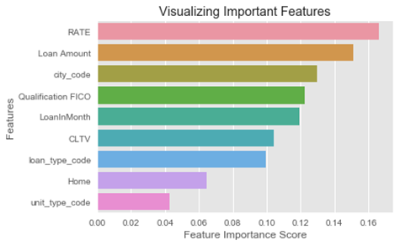
Random forests (RF): is a supervised learning algorithm.
Unscalled: Random Forest Classifier Accuracy : 0.78
Scalled: Random Forest Classifier Accuracy : 0.80
Finding Important Features in Scikit-learn

Slide 37
Logistic Regression & KNN
Logistic Regression Accuracy: 0.69 or 69%
Centering, Scaling and Logistic Regression
The performance of logistic regression did not improve with data scaling
After Scaling Synthesized Data
logistic regression score for test set: 0.925000 or 92.5%
With Scale and Synthesize the data we can see huge improvement on the KNN model accuracy.. 28% to 93%

Slide 38
Support Vector Regression (SVR)
SUPPORT VECTOR REGRESSION. SVR is a bit different from SVM.
SVR is an regression algorithm, use SVR for working with continuous Values instead of Classification which is SVM.
SVR accuracy: -0.0027 which is unacceptable for our Mortgage Loan Data Sets
A Support Vector Machine (SVM) is a discriminative classifier formally defined by a separating hyperplane.
With Tunning Parameter for SVM - Support Vector Classifier Accuracy : 0.6866267465069861 or 69%

Slide 39
KNN
KNeighborsClassifier Accuracy for Loan Types: 0.6826347305389222 or 68%
Preprocessing: scaling
k-NN score for training set: 0.770000 or 77%

Slide 40
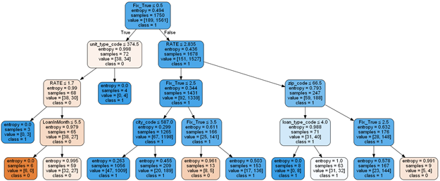
Using Scikit-learn, optimization of decision tree classifier performed by only pre-pruning. Maximum depth of the tree can be used as a control variable for pre-pruning. In the following the example, we can plot a decision tree on the same data with max_depth=4.
Decision Tree Classifier Accuracy : 0.839 or 83.4%

